Slide 1













Slide 2
Answer here
https://www.youtube.com/watch?v=IQJ4DBkCnco
Answer here
Answer here
Is your work saved?
Go Back to Lab Room

Slide 3
Type/draw here.
Type/draw here.
Type/draw here.
Continue to Part 2

Slide 4
Type/draw here.
Type/draw here.
Continue to Questions

Slide 5
Answer here
Answer here
Answer here
Is your work saved?
Go Back to Lab Room

Slide 6
Answer here
Go to Part 2

Slide 7
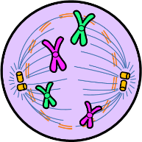
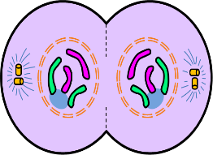
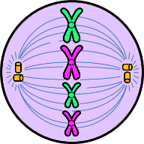
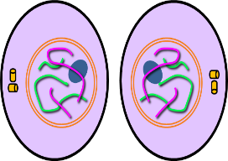
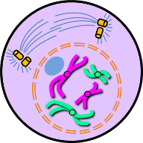
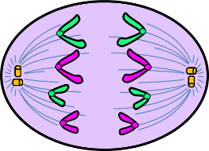
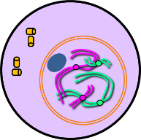
Is your work saved?
Go Back to Lab Room

Slide 8
Answer here
https://www.cellsalive.com/meiosis_js.htm
Answer here
Is your work saved?
Go Back to Lab Room

Slide 9
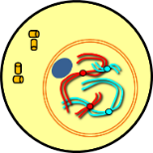
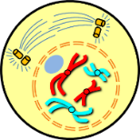
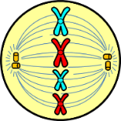
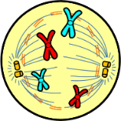
Interphase
Prophase
Prometaphase
Metaphase
The chromosomes align along the middle of the cell on the metaphase plate, an imaginary line that divides the cell in two.
The resting phase between successive divisions of a cell. The cell performs its normal cell activities during this phase.
The centrioles begin to attach their fibers to the chromosomes and move to the opposite ends of the cell in preparation for the next phase of mitosis.
The first stage of cell division during which the chromosomes become visible as paired chromatids and the nuclear envelope begins to fragment and disappear.
Go to Part 2

Slide 10
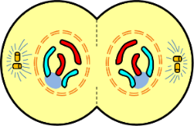
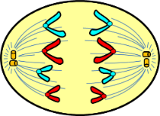
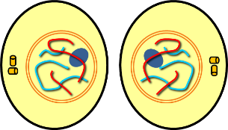
The chromosomes are now on opposite ends of the cell. A new nuclear membrane forms around each of the sets of chromosomes.
The rest of the cell divides. Cytokinesis, the division or the cell’s cytoplasm, is now complete. Two daughter cells are present and each one has an identical set of chromosome as the original cell.
The fibers from the centrioles begin to tug the chromatids towards opposite ends of the cell. Half of the chromosomes go to one side and the other half go to the other.
Anaphase
Cytokinesis
Telophase
Is your work saved?
Go Back to Lab Room

Slide 11
Go to Image Help

Slide 12
Is your work saved?
Go Back to Lab Room

Slide 13
Answer here
Go to Question 2

Slide 14
Answer here
Go to Question 3

Slide 15
Answer here
Is your work saved?
Go Back to Lab Room

Slide 16
Answer here
Answer here
Answer here
Go to Part 2

Slide 17
Answer here
Answer here
Answer here
Answer here
Answer here
Is your work saved?
Go Back to Lab Room

Slide 18
COMIC STRIP
WANTED POSTER
COMPARE AND CONTRAST
FLIPBOOK
Is your work saved?
Go Back to Lab Room

Slide 19
Is your work saved?
Go Back to Challenges
or
Go Back to Lab Room

Slide 20
Is your work saved?
Go Back to Challenges
or
Go Back to Lab Room

Slide 21
Is your work saved?
Go Back to Challenges
or
Go Back to Lab Room

Slide 22
Is your work saved?
Go Back to Challenges
or
Go Back to Lab Room

